Slide 1
ACCOUNT MANAGEMENT SYSTEM
TEAM
cHEbROLU RUKMINI
Harish m s
Makam surya teja
j navya Chandrika
sowmya palvai

Slide 2
INTRODUCTION
The Account Management System is an application for maintaining a person’s account in a bank. This application shows the working of a banking account system and covers the basic functionality of an Account Management System. To develop a project for solving financial applications of a customer in a banking environment in order to nurture the needs of an end banking user by providing various ways to perform banking tasks. This project is developed using Web servlets, JSP, Java, and MYSQL for storing databases and html, CSS, bootstrap for basic stylings and web design. The system is easy to use and interactive for customers. Thus, the features of this project will save transaction time and therefore increase the efficiency.
TECHNOLOGIES USED
Html, CSS, Bootstrap – for UI
JSP – For Server Processing
Java and JDBC – For creating classes, methods and connecting the databases
MySQL - For Creating tables and storing the records

Slide 3
MODULES
1)LOGIN Module
It includes login page for both customers and Admin
ADMIN can manage and administer day to day functions of a bank.
CUSTOMERS are bank depositors, who entrust their money, banking facilities, for storage and easy transferring from anywhere.
Admin can
a)create accounts for new customers .
b)check transaction details of particular customer by selecting name
c) They can view all list of user account details

Slide 4
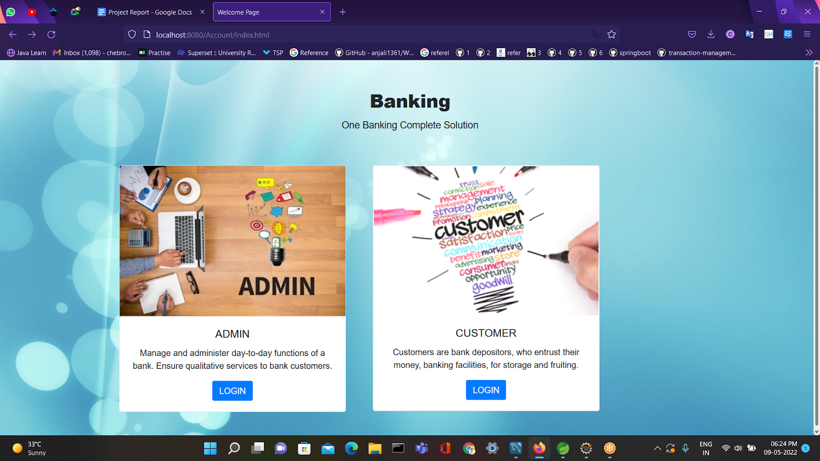
Main Page

Slide 5
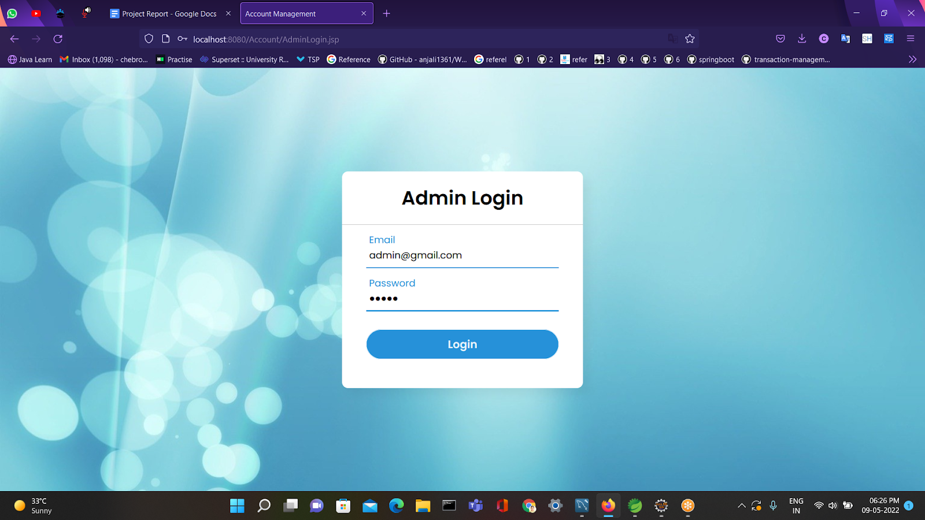
ADMIN LOGIN PAGE

Slide 6
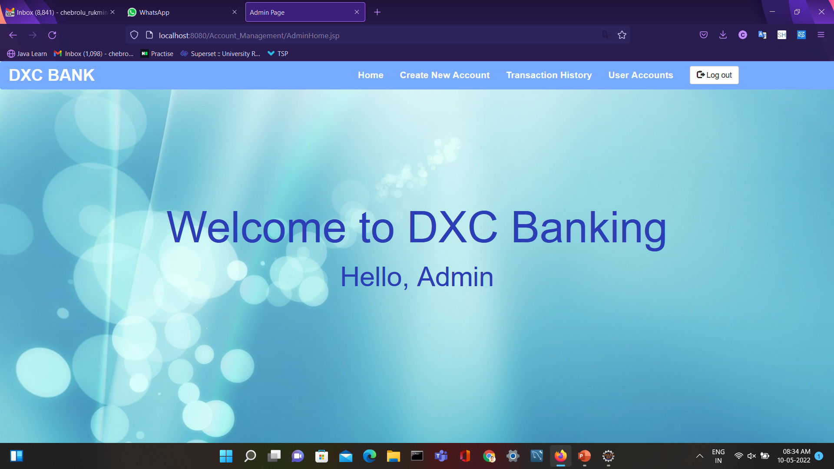
Welcome Page For Admin

Slide 7
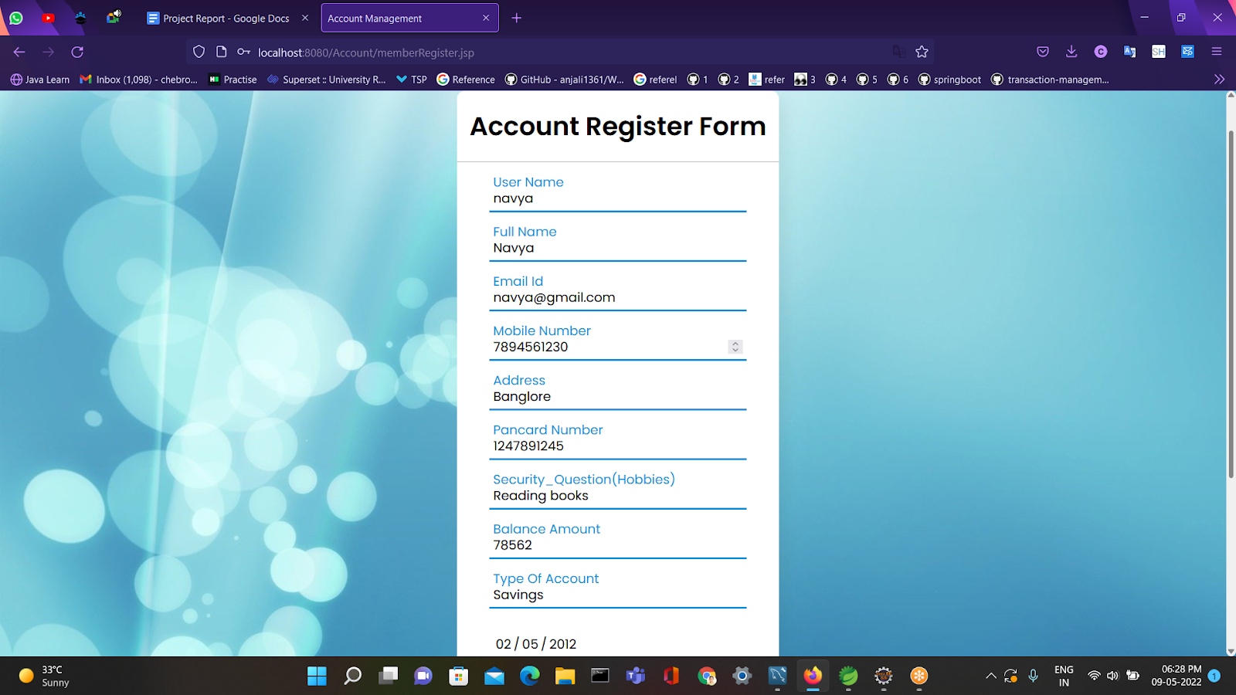
A)ADMIN CREATING NEW CUSTOMERS ACCOUNT

Slide 8
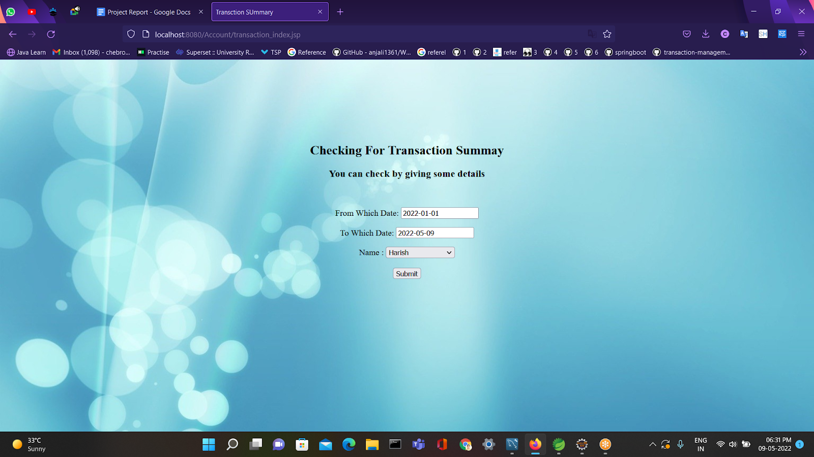
B)ADMIN CAN CHECK TRANSACTION DETAILS OF PARTICULAR CUSTOMER BY SELECTING NAME

Slide 9
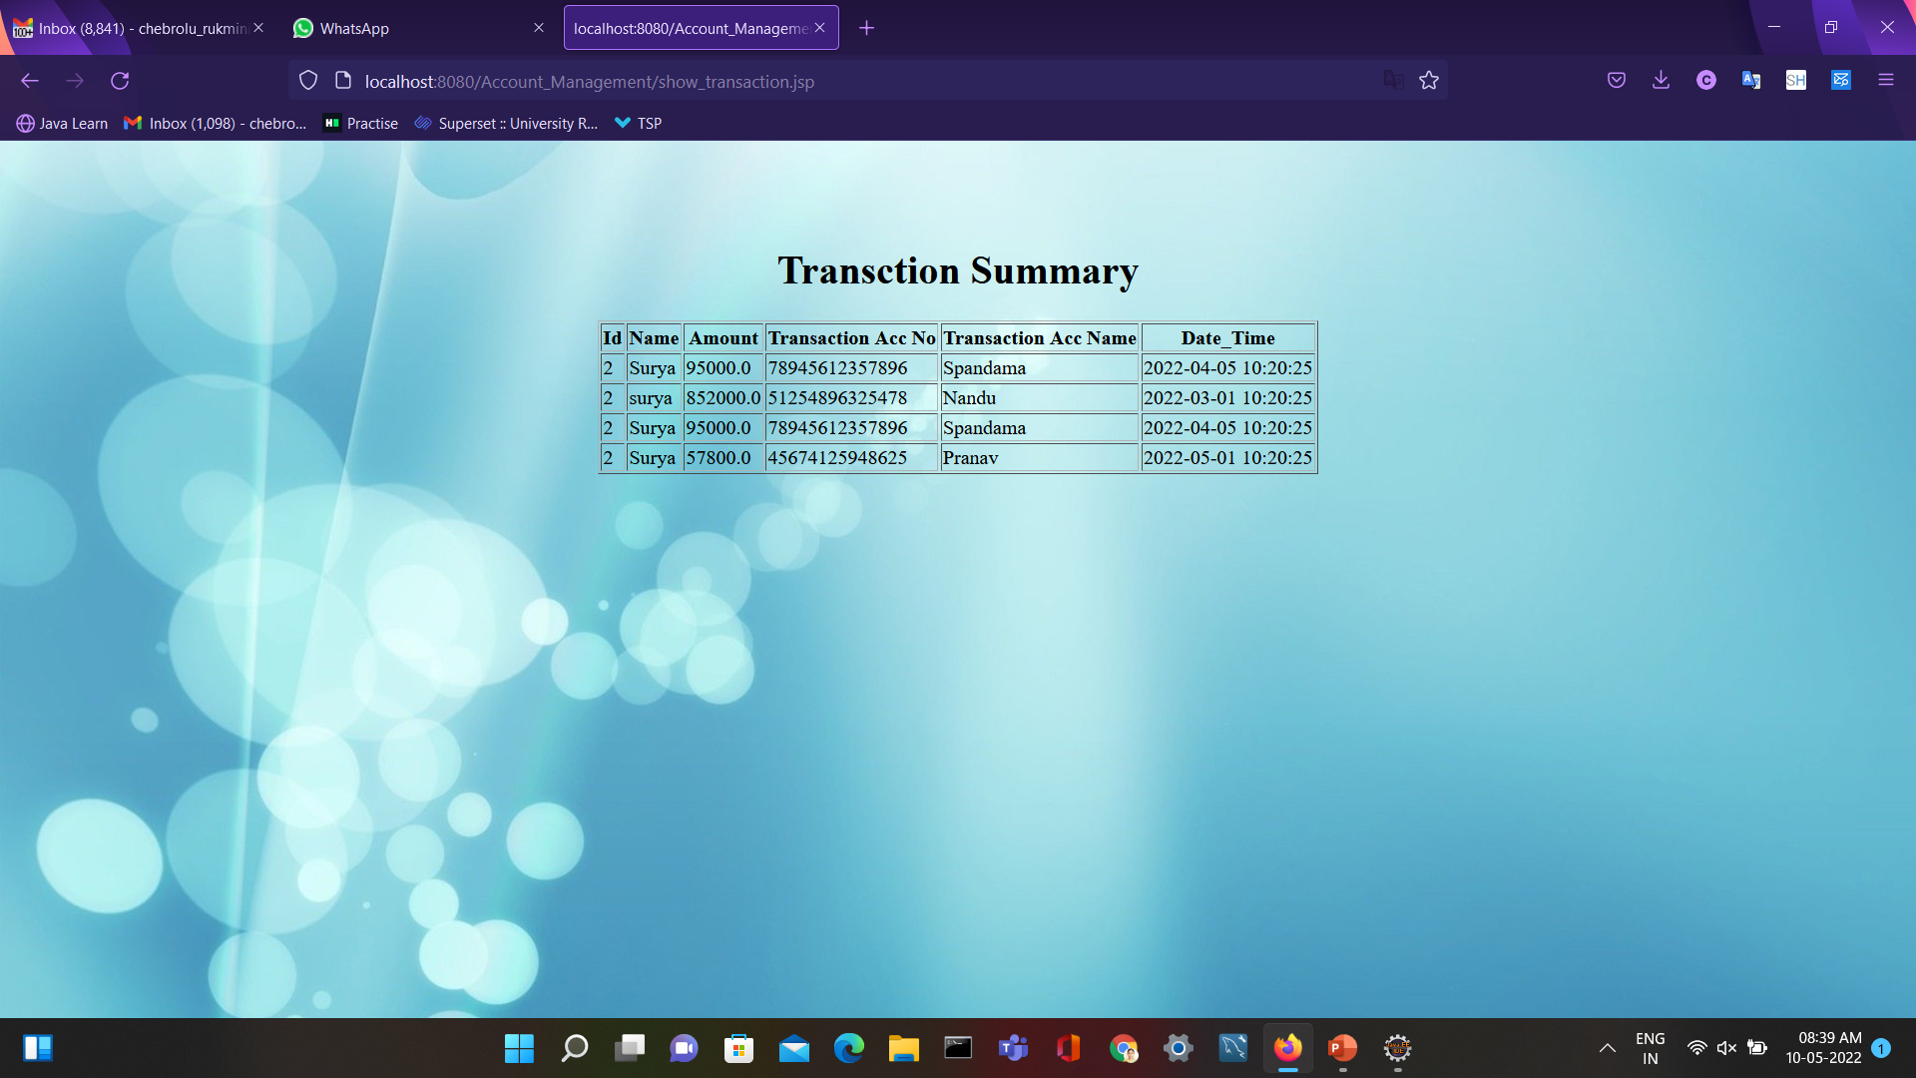
AFTER SEARCHING ADMIN CAN VIEW PARTICULAR TRANSACTION OF USER

Slide 10
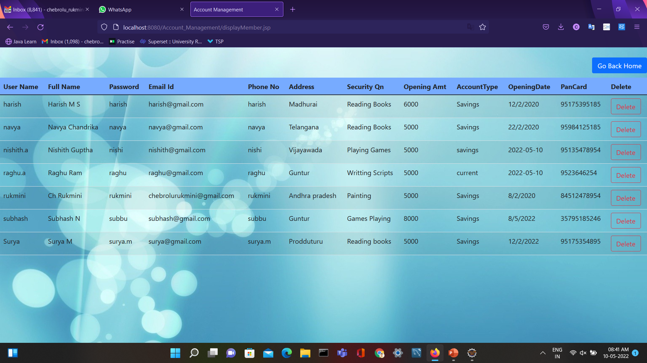
Admin Can View All User Account Details

Slide 11
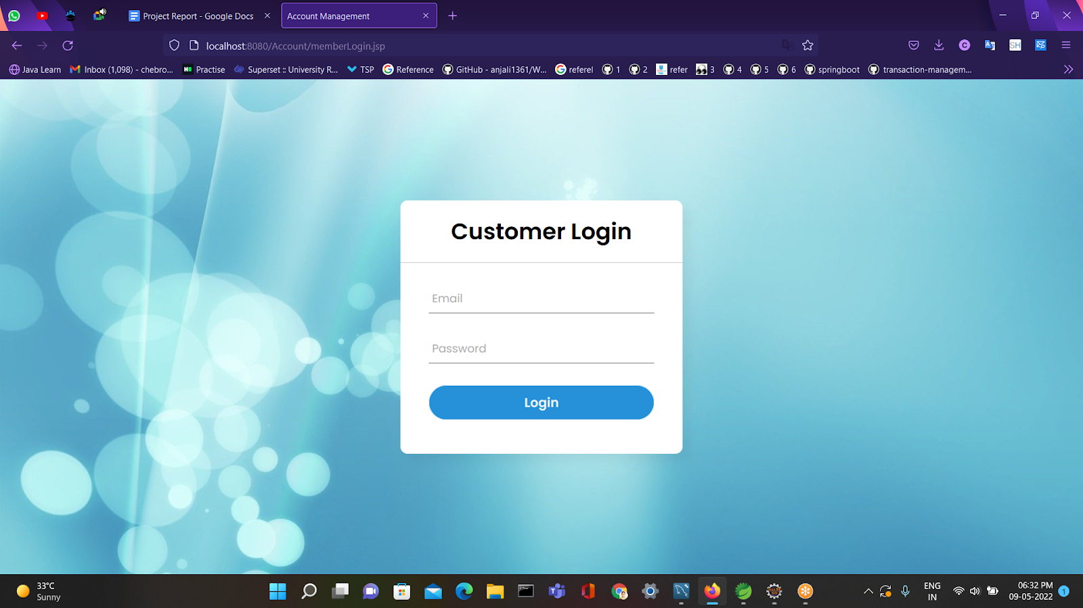
CUSTOMER LOGIN PAGE

Slide 12
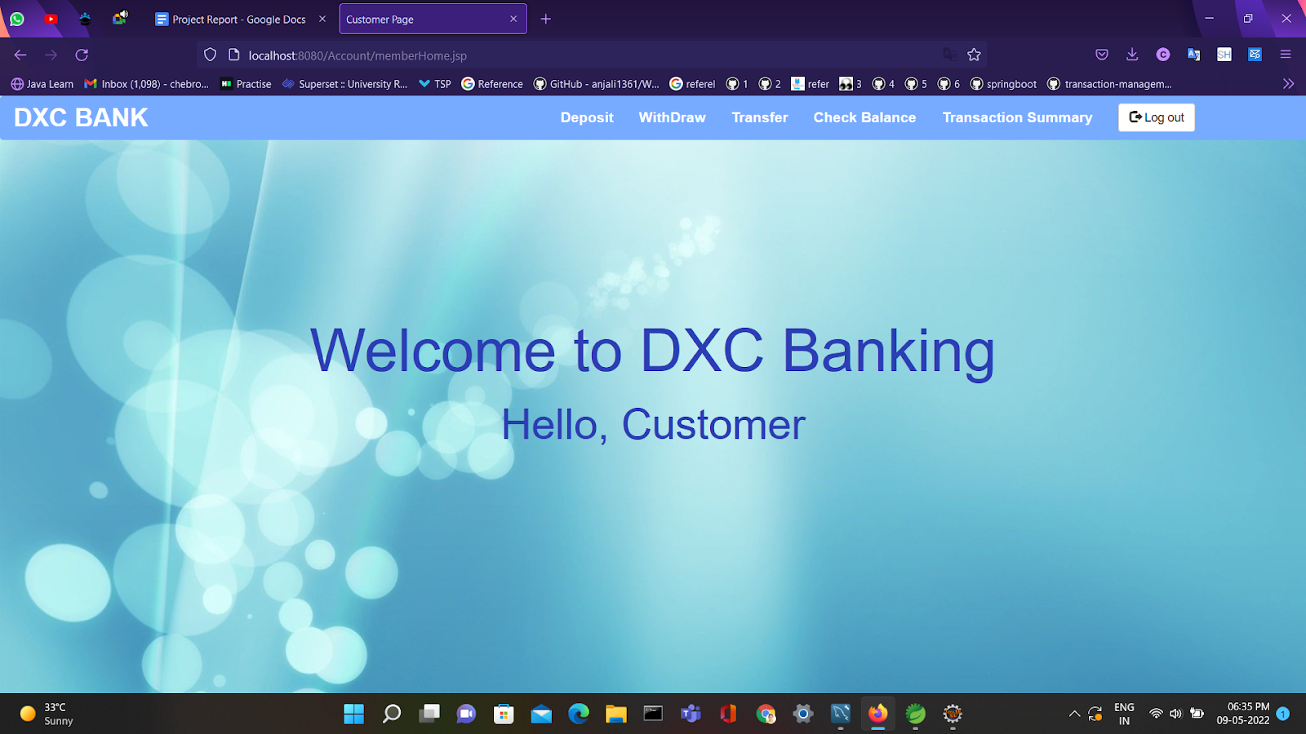
WELCOME PAGE FOR CUSTOMERS

Slide 13
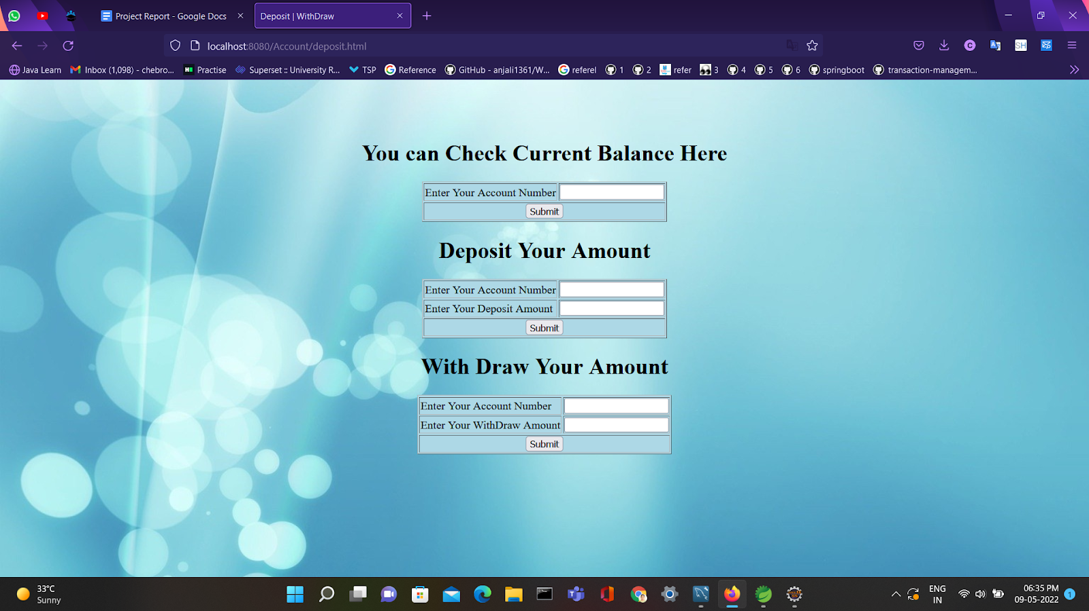
Now customer can deposit, withdraw or transfer money and can check balance

Slide 14
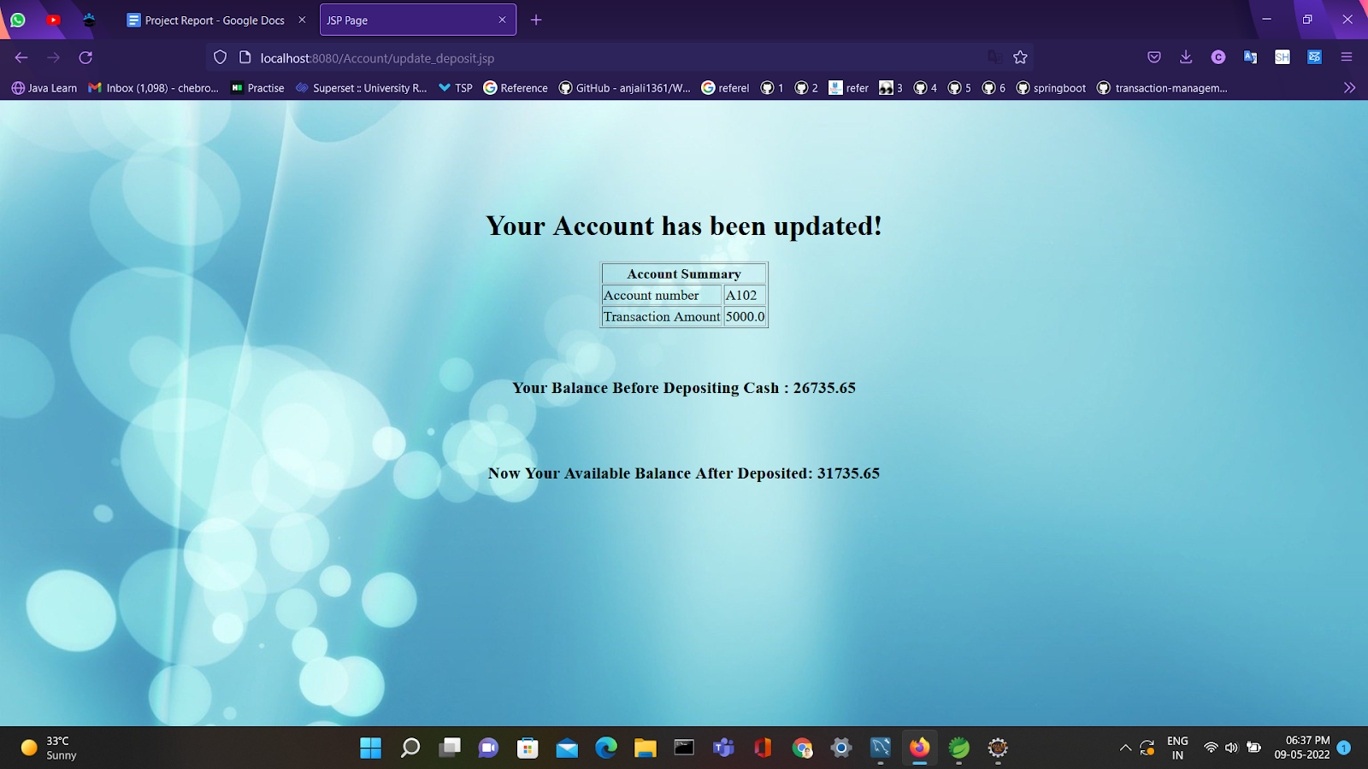
3)TRANSACTION AFTER DEPOSITING

Slide 15

AFTER WITHDRAW

Slide 16
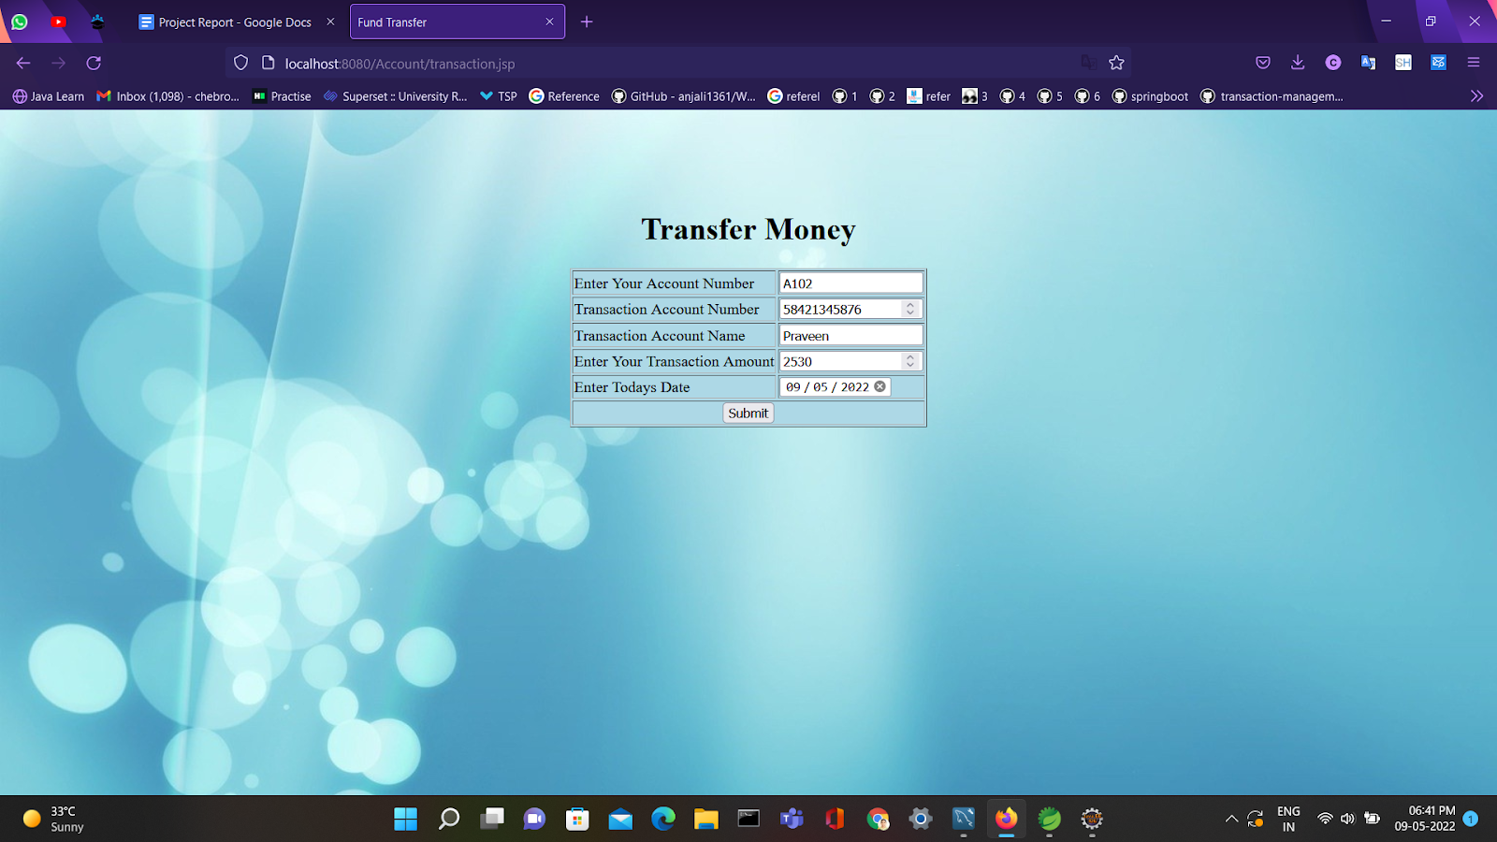
FUND TRANSFER

Slide 17
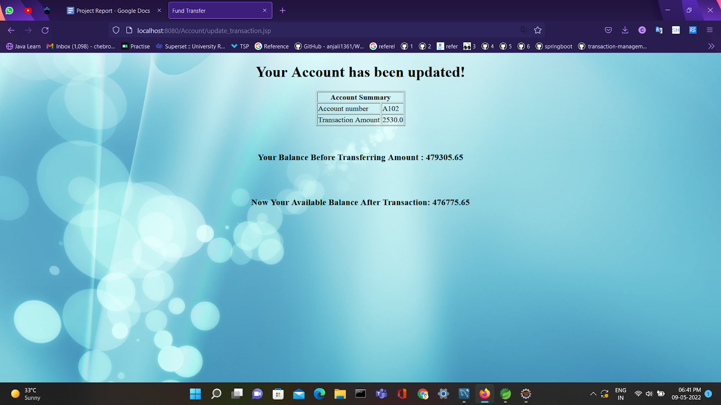
AFTER TRANSFERRING

Slide 18
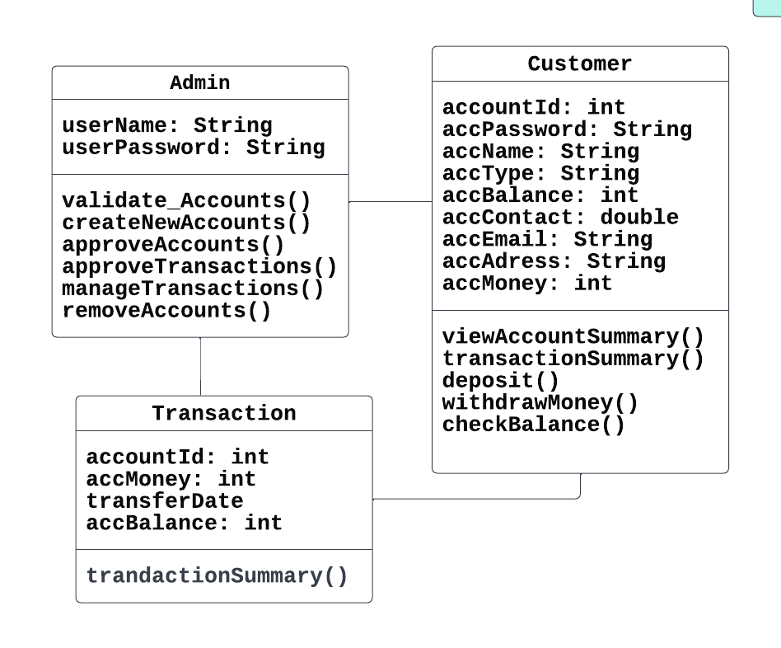
CLASS DIAGRAM

Slide 19
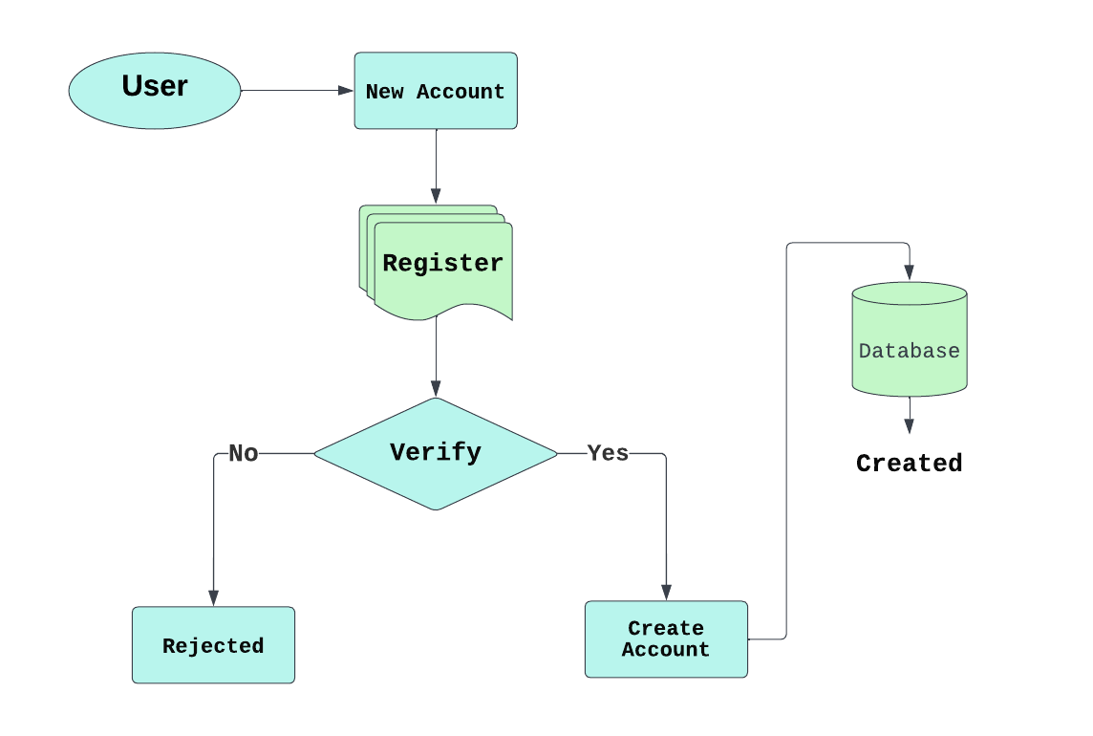
DFD FOR CREATING ACCOUNT

Slide 20
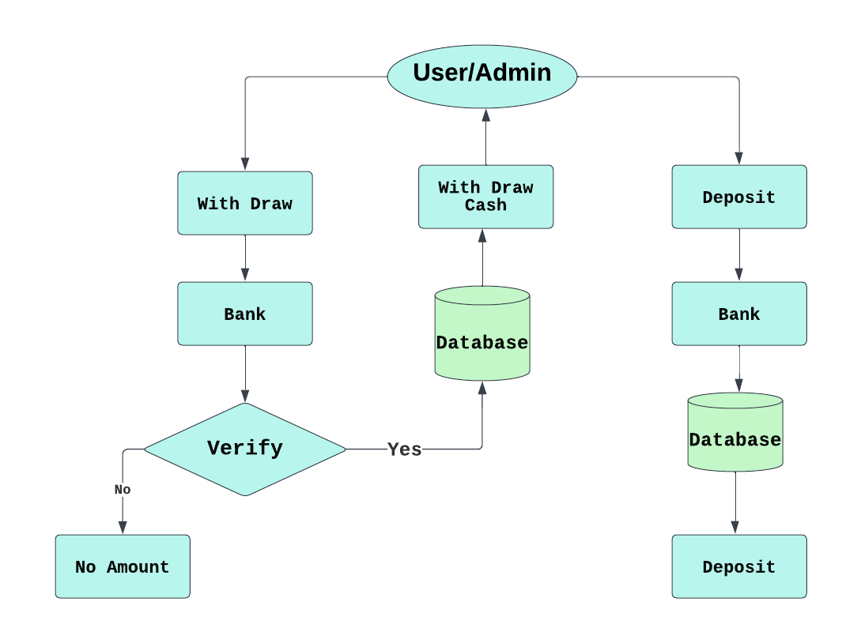
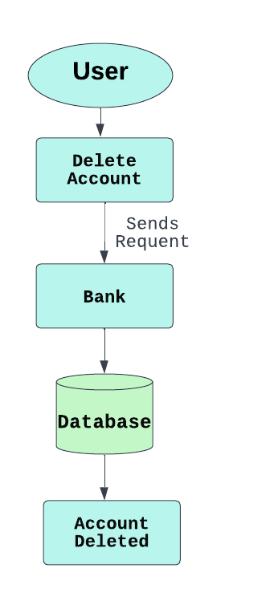
DFD FOR WITHDRAW, DEPOSIT AND DELETING

Slide 21
CONCLUSION
This project is developed to facilitate the needs of a user in a banking sector by embedding all the tasks of transactions taking place in a bank. Future version of this project will still be much enhanced than the current version. Online banking is an innovative tool that is fast becoming a necessity. It is a successful strategic weapon for banks to remain profitable in a volatile and competitive marketplace of today.

